Slide 1
Automatic Water Tap Project
Notes:
Good [morning/afternoon], everyone. Today, I am excited to present our my project on an Automatic Water Tap System. This system is an innovative and practical solution designed for improving hygiene and water conservation in everyday life. Let me walk you through how it works, its components, and impact it.

Slide 2
PRESENTED TO
Ria Dutta
Lecturer
Department Of Computer Science & Engineering
Varendra University
Susmita Paul
Lecturer
Department Of Computer Science & Engineering
Varendra University
Notes:
Thanks, mam for giving opportunity us to talk about our project.

Slide 3
Our team
Zibon Sarker
212311015
Mst. Nur Habiba
212311020
Shahorair Ahmed Shuvo
212311018
Notes:
I am _________. Here two of my teem met name is Shahorair Ahmed and Jibon Sarker.

Slide 4
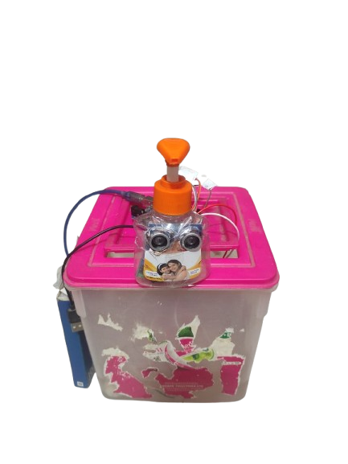
Introduction
Automatic Water Tap Project
Notes:
In today’s world, automation has become an integral part of our lives. One key area where automation can make a significant impact is water usage. Traditional taps often lead to water wastage because users forget to turn them off or touch them with dirty hands. My project solves these issues by automating the water tap using simple, cost-effective components like an ultrasonic sensor, a relay module, and a water pump motor.

Slide 5
Objectives
To create a contactless water tap system for enhanced hygiene. To minimize water wastage by ensuring the tap runs only when needed. To demonstrate how automation can be implemented using basic electronics and sensors.
Notes:
The objectives of this project are straightforward: To create a contactless water tap system for enhanced hygiene. To minimize water wastage by ensuring the tap runs only when needed. To demonstrate how automation can be implemented using basic electronics and sensors.

Slide 6
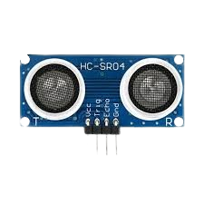
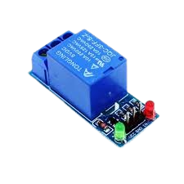
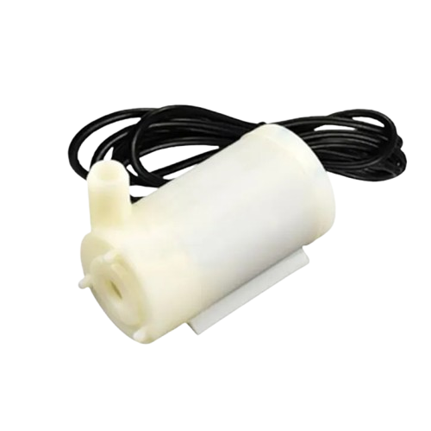
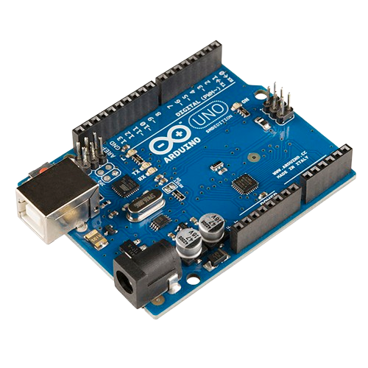
Components Used
Ultrasonic Sensor (HC-SR04)
Relay Module
Water Pump Motor
Arduino Microcontroller
Notes:
The main components of this project include:
Ultrasonic Sensor (HC-SR04) – It detects the presence of an object, like a hand, within a predefined range.
Relay Module – Acts as an electronic switch to control the water pump motor.
Water Pump Motor – Pumps water to the tap when activated.
Arduino Microcontroller – The brain of the system, which processes the sensor's input and controls the relay.
Additional components like wires, power supply, and a water reservoir complete the setup.

Slide 7
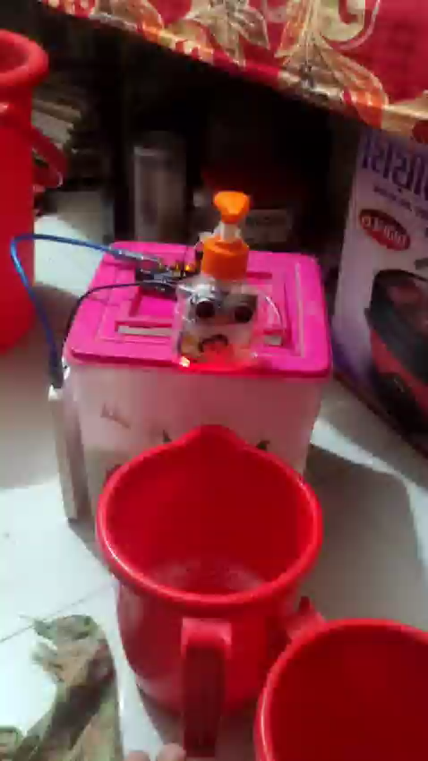
Working Principle
Notes:
Let’s dive into how the system works:
The ultrasonic sensor continuously emits ultrasonic waves and measures the time it takes for the waves to reflect back from an object.If the detected object, such as a hand, is within a specific range, the Arduino activates the relay.The relay turn on that powers the water pump motor, allowing water to flow through the tap.Once the object is removed, the sensor detects no obstacle, and the Arduino turns off the relay, stopping the motor

Slide 8
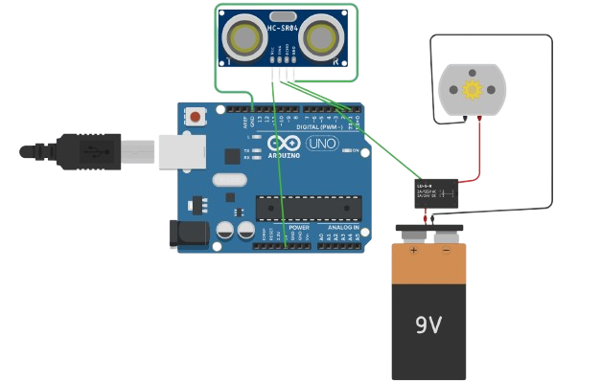
Circuit Diagram
Notes:
This slide shows the circuit diagram of the system. The ultrasonic sensor’s Trig and Echo pins are connected to the Arduino for distance measurement. The relay module is connected to one of the digital output pins of the Arduino to control the water pump motor. The pump is powered through the relay, ensuring electrical isolation and safety.

Slide 9
Key Features
Touchless Operation: Reduces pollution, ideal for kitchens,
bathrooms, and public spaces.
Water Conservation: Automatically stops water flow when not needed,
preventing wastage.
Cost-Effective: Built with affordable, widely available components.
Customizable: Detection range and water flow duration can
be easily adjusted.
Notes:
Touchless Operation: Reduces pollution, ideal for kitchens, bathrooms, and public spaces.
Water Conservation: Automatically stops water flow when not needed, preventing wastage.
Cost-Effective: Built with affordable, widely available components.
Customizable: Detection range and water flow duration can be easily adjusted.

Slide 10
Demonstration
Notes:
Here you can see! Or Here’s a demonstration of the project in action. As you can see, when an object, like a hand, approaches the sensor, the motor is activated, and water starts flowing. Once the object is removed, the motor stops, and the tap shuts off automatically. This simple yet effective system ensures water is used only when necessary.

Slide 11
Benefits
Enhanced hygiene: completely touchless, reducing the spread of germs.
Water savings: perfect for water-scarce areas by ensuring zero wastage.
Eco-friendly and sustainable: encourages responsible water usage.
Scalable solution: can be implemented in homes, offices, or public restrooms.
Notes:
Some of the key benefits of this project include:
Enhanced Hygiene: Completely touchless, reducing the spread of germs.
Water Savings: Perfect for ensuring zero wastage.
Eco-Friendly and Sustainable: Encourages responsible water usage.
Scalable Solution: Can be implemented in homes, offices, or public restrooms.

Slide 12
Challenges and Solutions
Sensor sensitivity: initially, the sensor detected objects beyond the desired range. I resolved this by calibrating the distance threshold in the code.
Relay control: ensuring the relay operated reliably required proper wiring and using an external power supply for the motor.
Water flow control: adjusting the motor and pump specifications to provide consistent water flow took some trial and error.
Notes:
While working on this project,
We encountered a few challenges:
Sensor Sensitivity: Initially, the sensor detected objects beyond the desired range. I resolved this by calibrating the distance threshold in the code.
Relay Control: Ensuring the relay operated reliably required proper wiring and using an external power supply for the motor.
Water Flow Control: Adjusting the motor and pump specifications to provide consistent water flow took some trial and error.

Slide 13
Future Improvements
Adding a flow sensor to monitor and limit water usage further.
Integrating a battery backup to ensure functionality during power outages.
Connecting to a smart home system for remote control and monitoring.
Notes:
In the future, this project can be enhanced by:
Adding a flow sensor to monitor and limit water usage further.
Integrating a battery backup to ensure functionality during power outages.
Connecting to a smart home system for remote control and monitoring

Slide 14
Conclusion
Notes:
This project demonstrates how automation can simplify daily tasks while promoting sustainability and hygiene.
The automatic water tap is a small step toward smarter living and better resource management. Thank you for your attention, and I’m happy to answer any questions!

